Slide 1
American Life in the Seventeenth Century
Chapter Four
The American Pageant

Slide 2
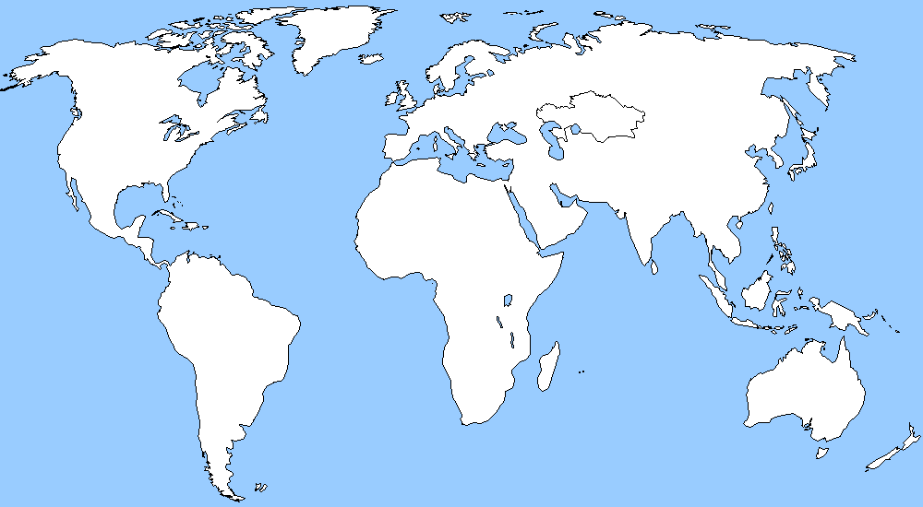
Collision of Three Cultures
Europe, Africa, Natives
All in a “New World” together
Must adapt to surroundings and each other
Distance and time matter…why?

Slide 3
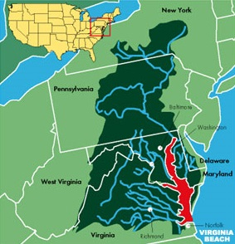
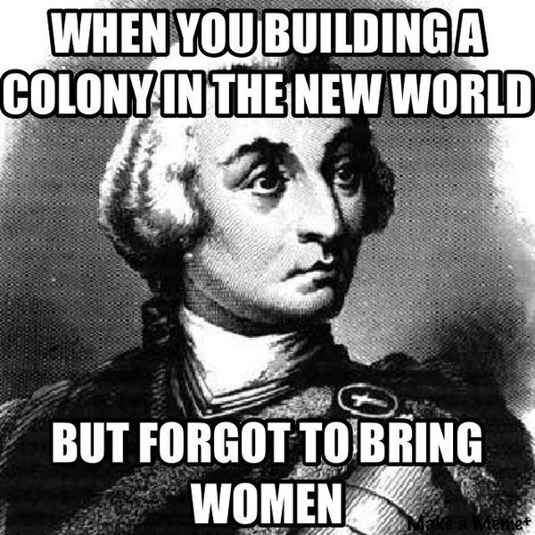
Life in the Chesapeake
Virginia
Unhealthy: malaria, dysentery, typhoid
Life expectancy DOWN ten years –lucky to see 20 years old
Most growth happens through immigration
Men outnumber women 6-1
Immunity builds; more women arrive –birthrate on rise by 18th Century
59,000 citizens in Virginia
30,000 in Maryland

Slide 4
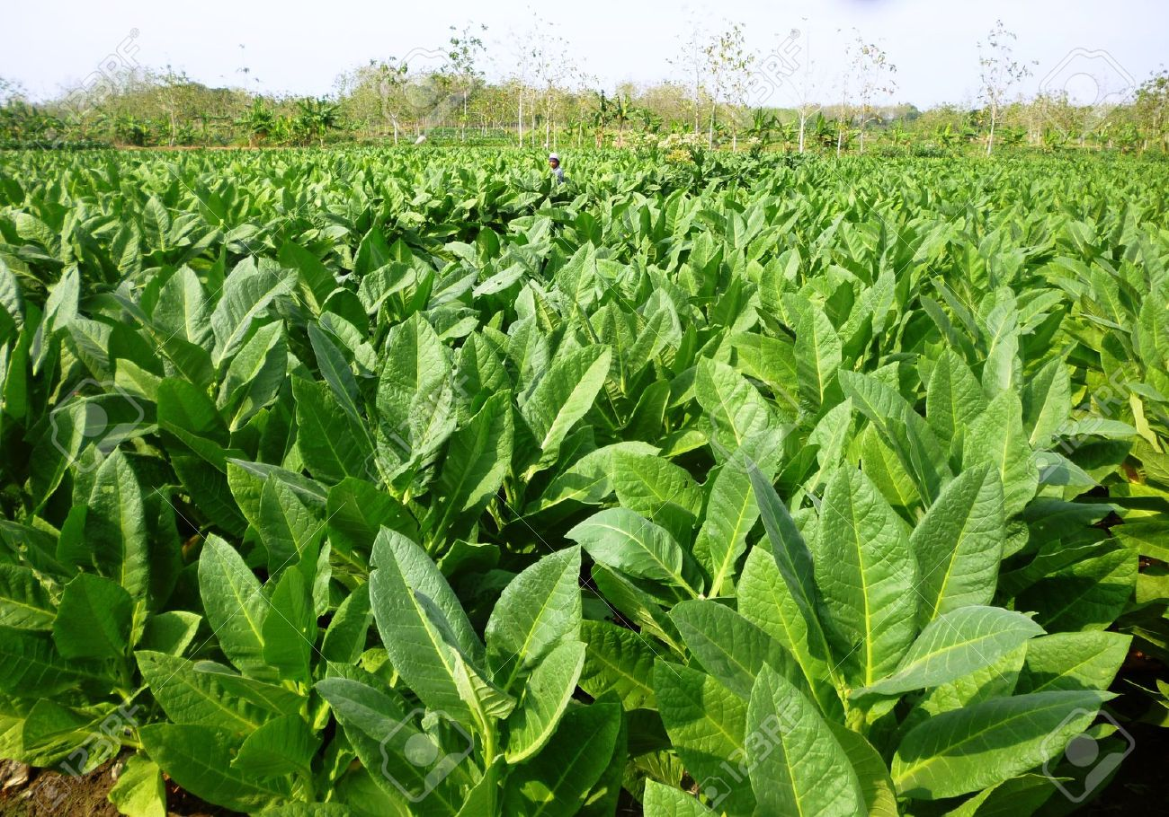
Runs on Tobacco
Remember—tobacco economy
Plant tobacco to sell before planting corn to eat!
Tobacco eats up land—move further inland
______________________ ←Problematic
Leads to overproduction—drives prices ______________.
From 1.5 million pounds to 40 million pounds
Colonists respond by growing more!
Big Picture:
Rise of Indentured Servitude*
Use of Headright System* (VA, MD)
(pay of passage of laborer, get 50 acres; masters profit; servants stay weak)
Leads to the rise of African slavery
African slaves not used largely at first—too expensive and risky
Land runs out, servants lose patience

Slide 5
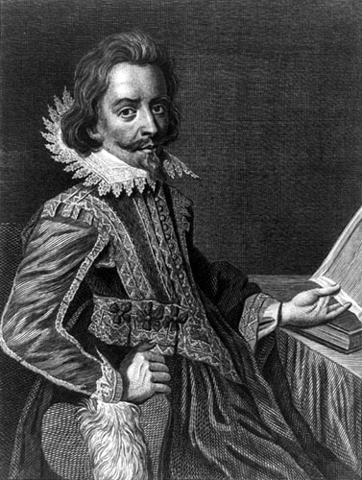
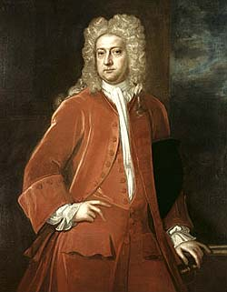
Bacon’s Rebellion
Its Legacy:
Rich vs. Poor
Rising Tensions
Rise of African slavery
Virginia, 1676
Single men. No land. No women. No money. = Trouble
Nathaniel Bacon - planter leads rebellion against William Berkley
Favorable Indian policies hurt planters
Indians attack frontiersman—Berkley does nothing
Indians massacred—friendly and hostile
Berkley chased out of VA
City is torched
vs.

Slide 6
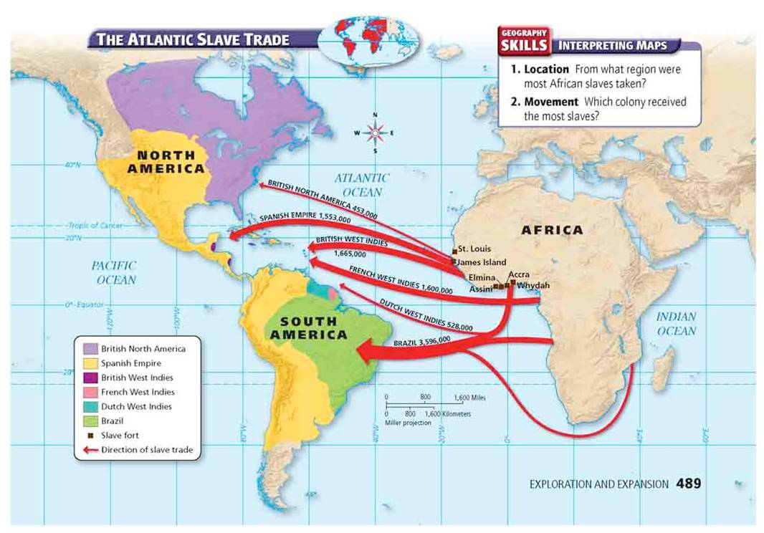
Slavery Booms
Royal African Company loses its
monopoly on slave trade—Americans seize the opportunity!
RHODE ISLAND –BRINGS IN 10K SLAVES OVER A DECADE’S TIME!
Between 1492-1700→ 7,000,000 African Slaves
400k in North America after 1700
Most go to South America; West Indies
2,000 in VA (out of 35,000)
Not too many own slaves—risky
So…why does it “boom”
Wages rise in England
Mortality rate improves
By 1680s—African slaves outnumber white servants
1700:
Africans make up 1/3 of South Carolina’s Population
Within Twenty Years later– Africans outnumber white 2:1
By 1750—Africans make up half of VA’s population

Slide 7
Middle Passage

Slide 8
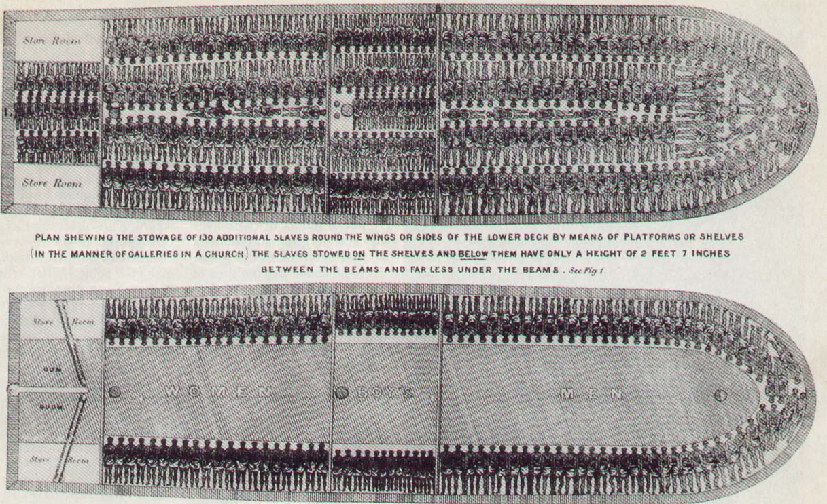
Servant or Slave?
Not a clear difference
Until—1662: Virginia Slave Codes
Defines slavery based on race (chattel)
No education.
No Religion.
Nothing frees you.

Slide 9
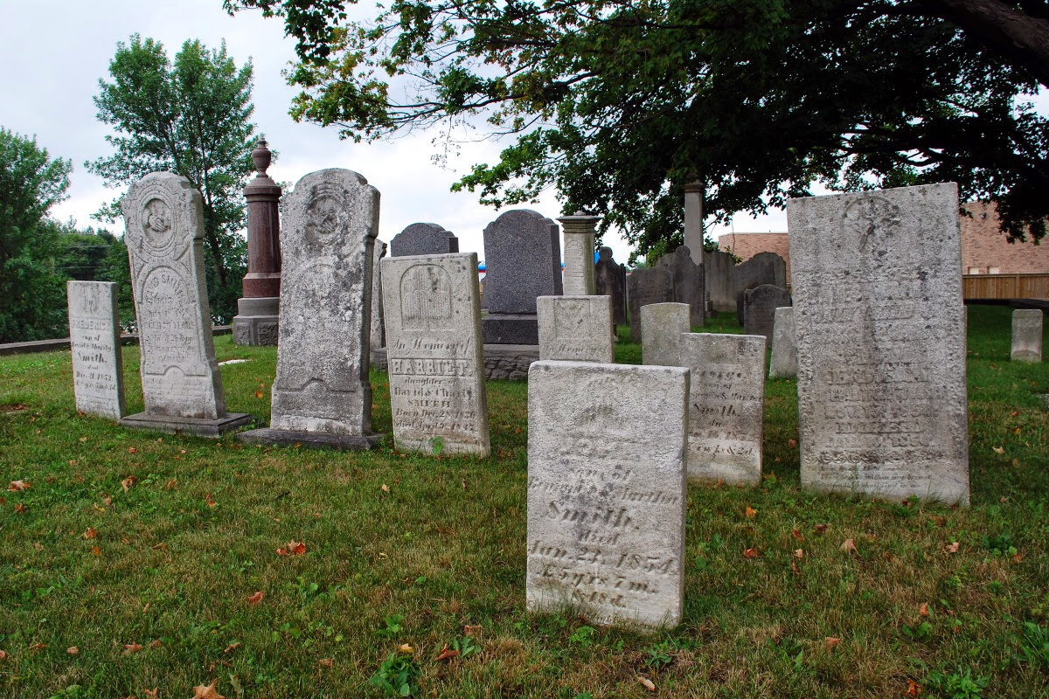
Life in the South
Growing gap between rich and poor
Rich monopolize political power—House of Burgesses
The rich still work!
Have to deal with lazy, drunk servants
Let’s make a deal
Overall, society is generally poor
Farmers, indentured servants
Rural setting over urban
Most navigate by water—roads too bad

Slide 10
The New England Family
Life is easier in the North
Better temperatures, cleaner water—adds 10 years to lifespan
Puritans live up to 70
Chesapeake | New England
-Migrates as individuals | -Migrates as families
-Loses ten years to lifespan | -Add ten years to lifespan
-Population declines | -Population increases
-High pre-marital birthrate | -Early marriage—8/10 pregnancies carried to term
-Land rights for widows | -Children learn obedience, nurturing, parents/grandparents
 | -Low pre-marital birthrate
 | -Women give up property rights at marriage

Slide 11
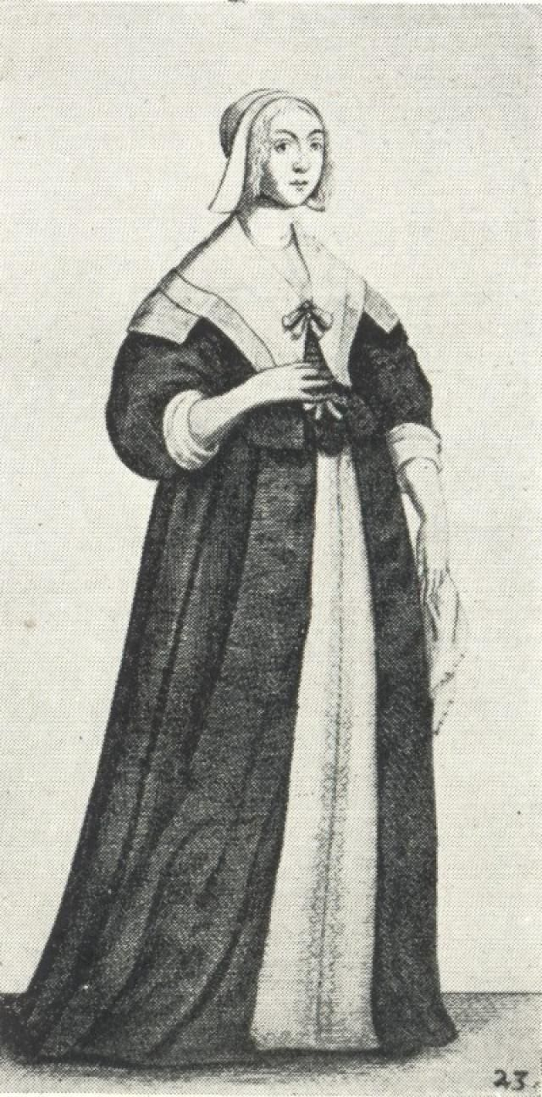
Women’s Role in Society
“The wife accounts subjection her honor”
Women seen as weaker of the two genders (Eve)
BUT—starts to change
Husband’s power over wife is not absolute
Abusive spouses, Midwives, Portraying women
Puritan Goal: Preserve marriage
Low divorce rate
Adultery, abandonment, The Scarlet Letter

Slide 12
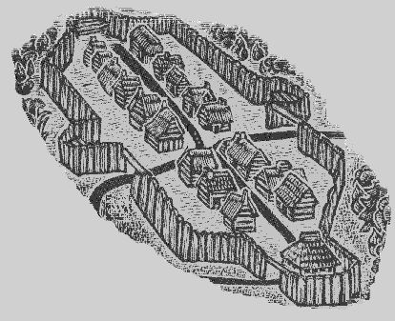
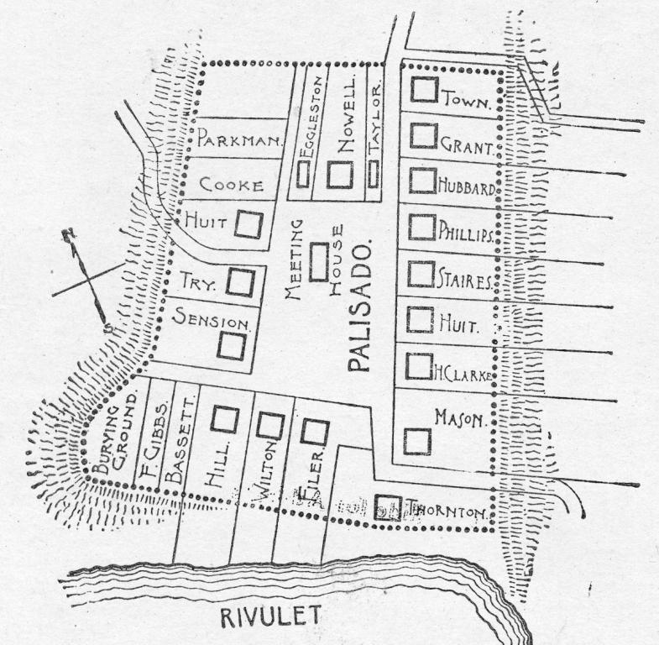
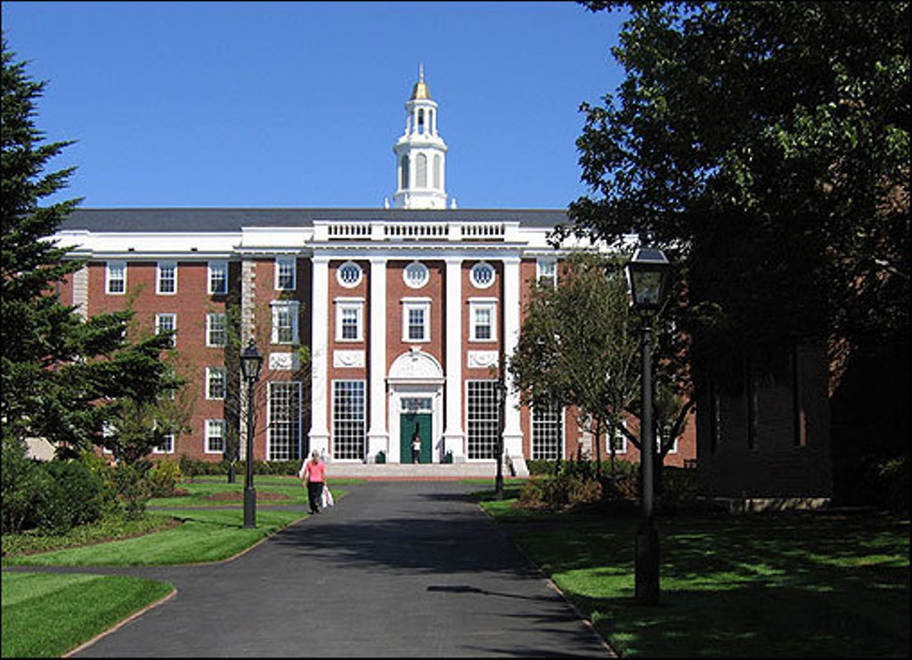
Life in New England Towns
Tight-knit; small community—aim to abolish slavery in Puritan towns
Why? Geography!
Indians, Dutch, French
50+ families—elementary education
More than half of adults read and write
Harvard begins—goal is to train up ministers
Life expectancy among Puritans is 80 years
Chesapeake | New England
Towns form sparingly | Orderly
Lone Wolf | Chartered
 | Planters (Proprietors)
 | Then take land and spread it
Puritans establish the Congregational Church—men meet, men vote on every-day matters--democracy

Slide 13
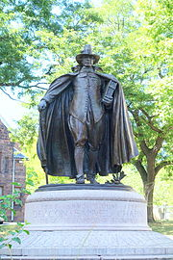
Half-Way Covenant
Population on the rise—people spread out…and farther from the Church
Faith burns bright, but gets more dim with time
Hell, fire and brimstone sermons // Jeremiad
Fewer conversions
Establish a half-way covenant
Partial church membership for those who are baptized
Baptized but unconverted parents present their children from baptism
Controversial! Lowering standards?
Women begin to make up majority of church members

Slide 14
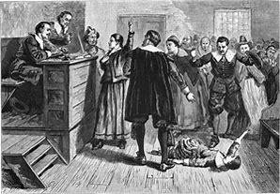
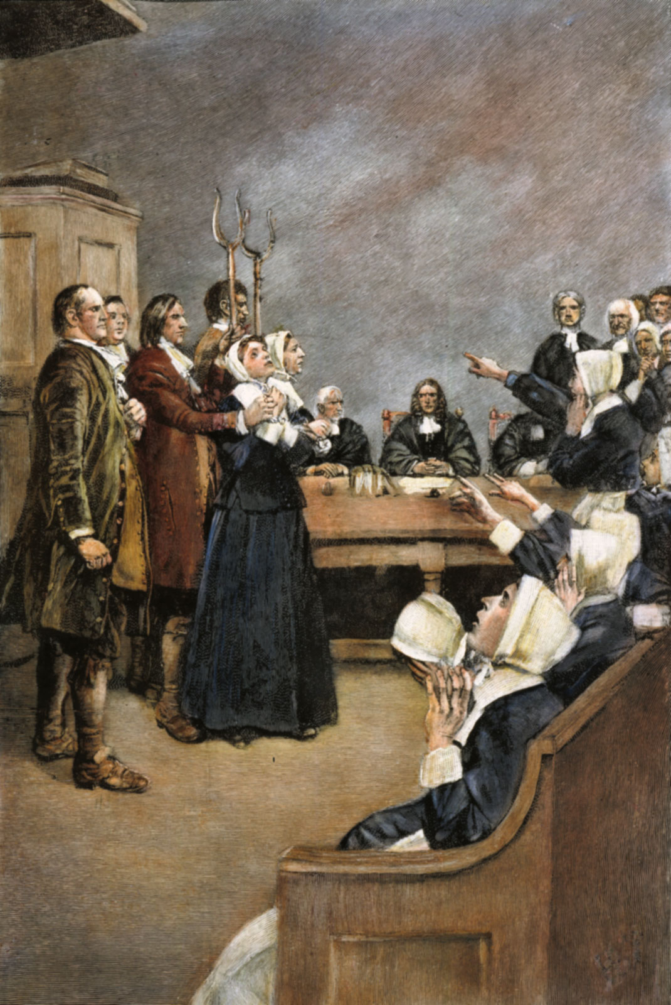
Salem Witch Trials
Massachusetts
Girls claim to be bewitched by older women
Witch hunt—20 people lynched
Even a dog!
Most of the accused were from wealthy families—market economy, property-owning
Accused by the poor (subsistence)
Eventually put to an end
Governor’s wife is accused of being a witch—he pardons her.
Ends the trials

Slide 15
Earliest Settler’s Days and Ways
Way of Life Dictated By Sun
-Plant in spring, tend in summer, harvest in fall, prep in winter
-Rise at dawn, sleep at dusk
Women-tend to family
Men-hunt and plant
Kids—both and school
Geography makes it difficult to plant—focus on industry
Not much intermarriage—outsiders don’t care for land or sermons
Brutal weather—HOT summer, FRIGID winter
Economy reliant on slavery and tobacco
Geography Built By Natives:
-Trails for hunting
-Burn woodlands, restoration
-Use of / occupation of land
-Europeans bring in livestock—changes shape of land

Slide 16
Earliest Settler’s Days and Ways
Land was relatively cheap—still expensive for common man
Less available in South-most that are coming are poor
Tensions rise between rich and poor (repeating theme!)
Leisler’s Rebellion—1689-1691
Merchants vs. Landholders
Response to Glorious Revolution
Ill-fated
Add to all that…
Rich will pass laws to keep the “lower class” in their place.
MA—laws are passed to keep poor from wearing Gold and Silver
VA—Tailor will be fined for having his horse race
Gaps between rich and poor—equality in America based on race.

